Slide 1

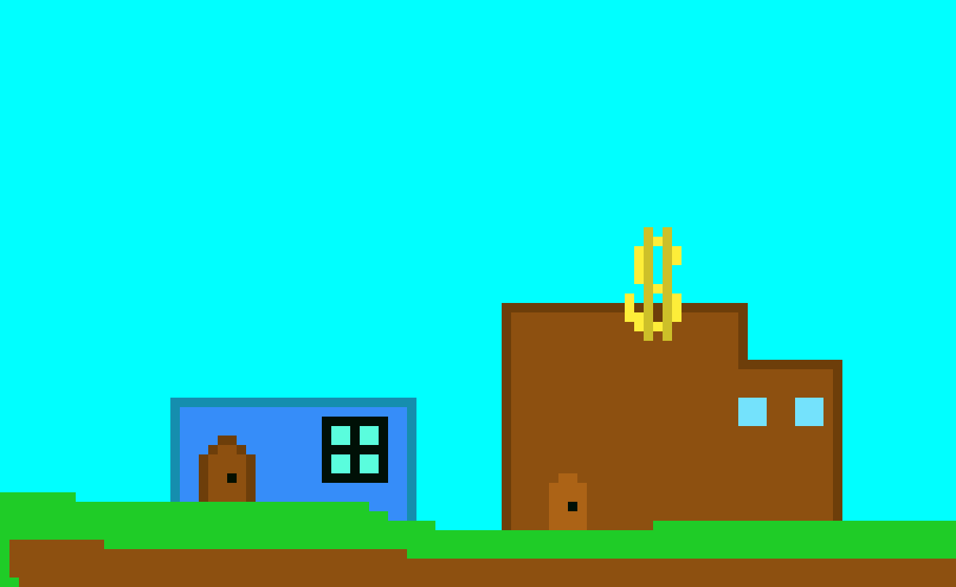
How it will look
MYNT

Slide 2

How it will sound
Eric Skiff
Eric Skiff

Slide 3

Quirk

